Slide 1
Virtues & Vices

Slide 2
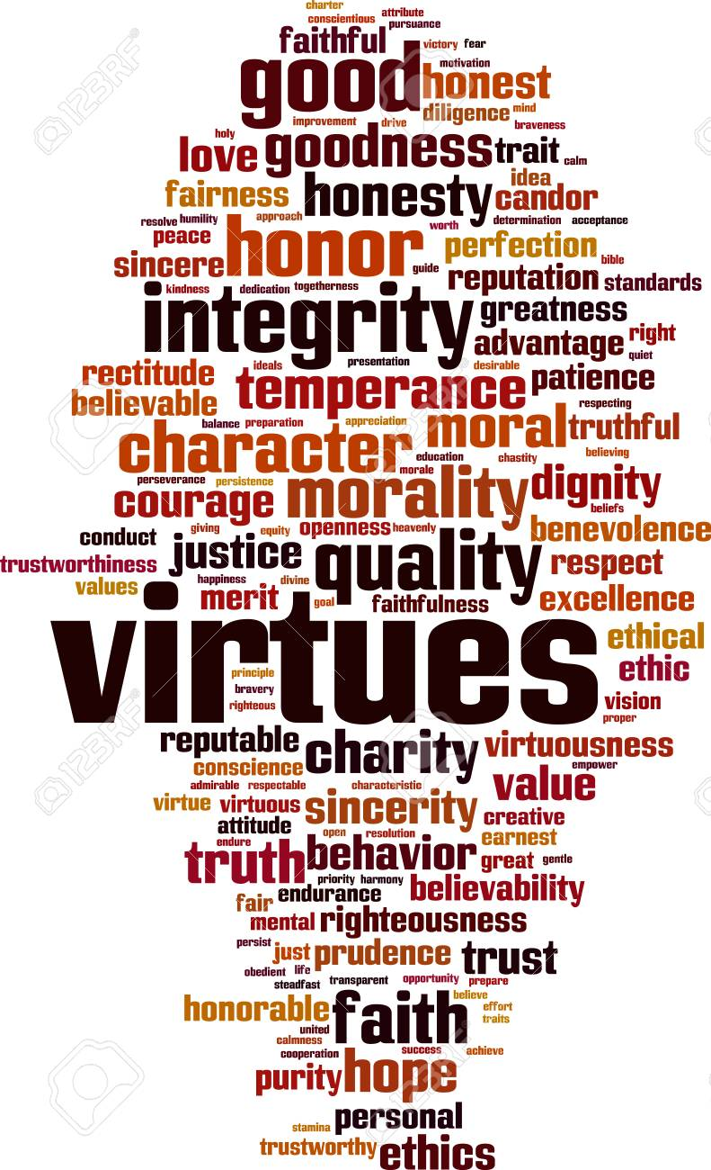
Virtues
Are attitudes and habits that make us more likely to choose what is good even when we don’t stop to think about it. They are good behaviours that come naturally to us.

Slide 3
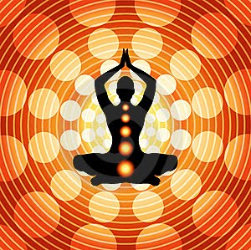
Virtues help us take control of our lives
Virtues help us channel our emotions and void doing things we will regret

Slide 4
We develop our virtues through
- Education
- Prayers
- Practice

Slide 5
God created us to be virtuous people.
The more often we act out a virtue, the stronger that virtue will become.
If we develop virtues then the choices that come naturally will be in keeping with God’s will.

Slide 6
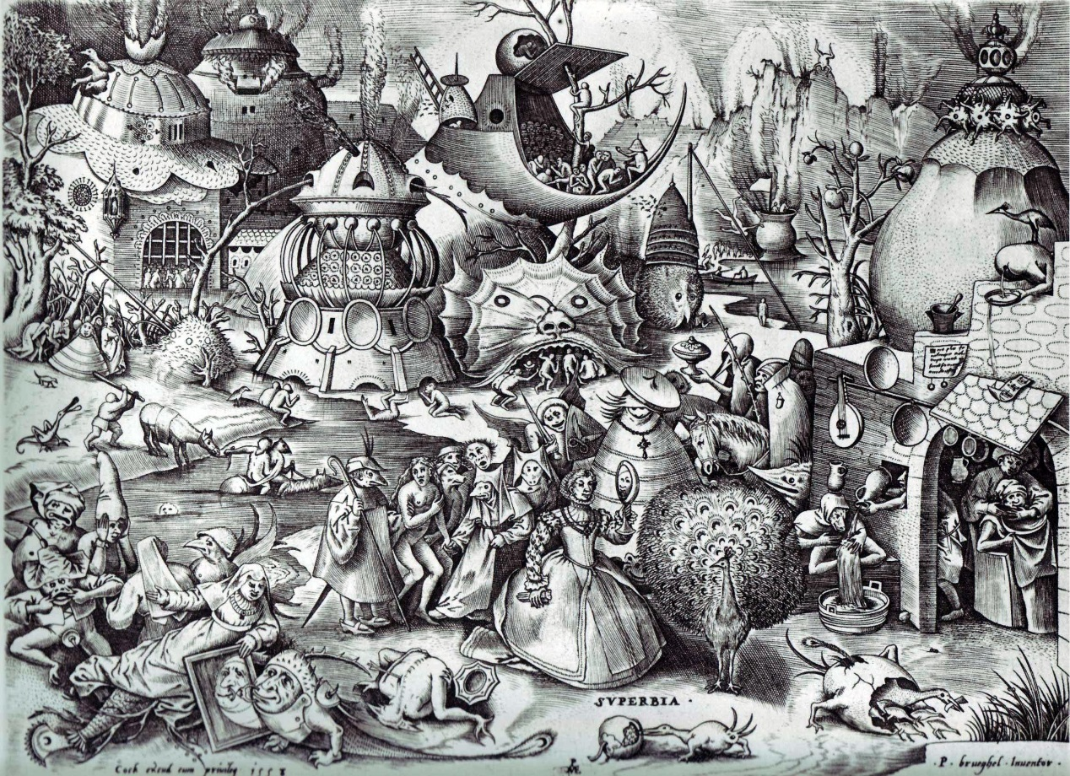
If we fail to develop our virtues, our habits tend to be selfish.
The actions that come naturally will tend to be opposed to God.

Slide 7
Be at our best
Throughout this course, we will be exploring a variety of virtues we need to develop if we wish to be the best people and the best friends that we can be:

Slide 8
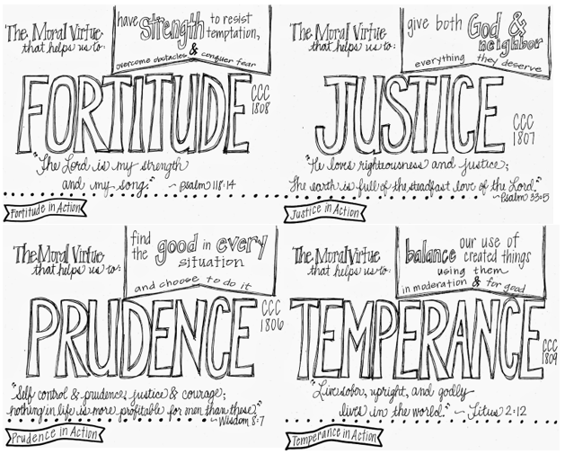
4 cardinal virtues (by the Church)

Slide 9
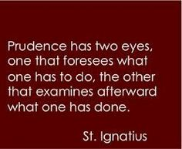
1. Prudence
Aka hinge virtue
Defined as having wisdom and common sense
Moral virtue
Carefulness, concern, diligence, precaution, reasoning, discretion

Slide 10
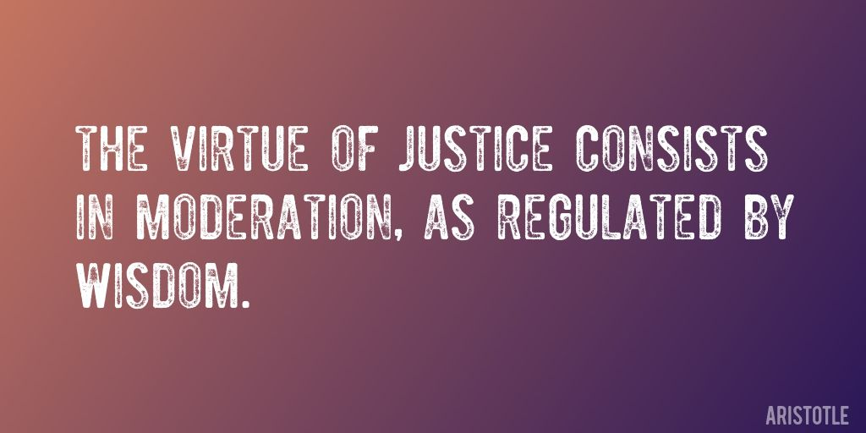
2. Justice
Giving to people that which they are owed to
Fair treatment
Equity
Righteousness

Slide 11
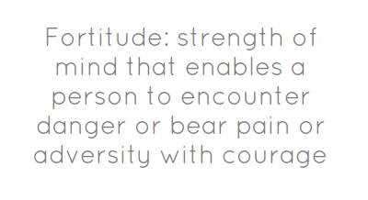
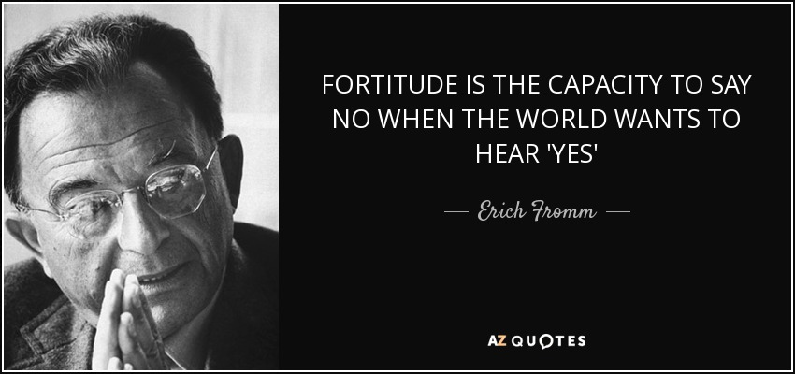
3. Fortitude
Courage or strength
Will power
Fearlessness
Bravery
Enduring to reach goal

Slide 12
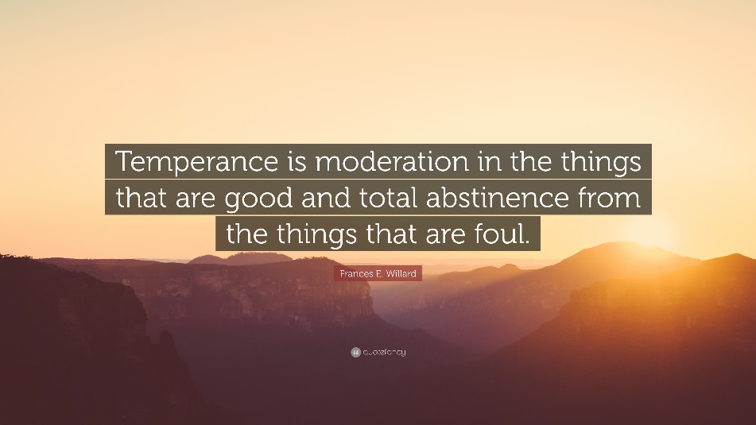
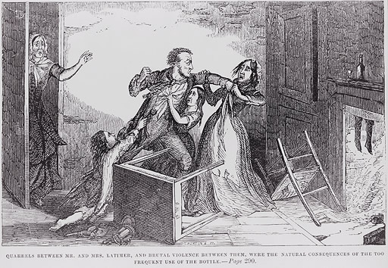
4. temperance
Self-control
Self-restraint
Abstinence
Moderation
Sacrifice
Discipline

Slide 13
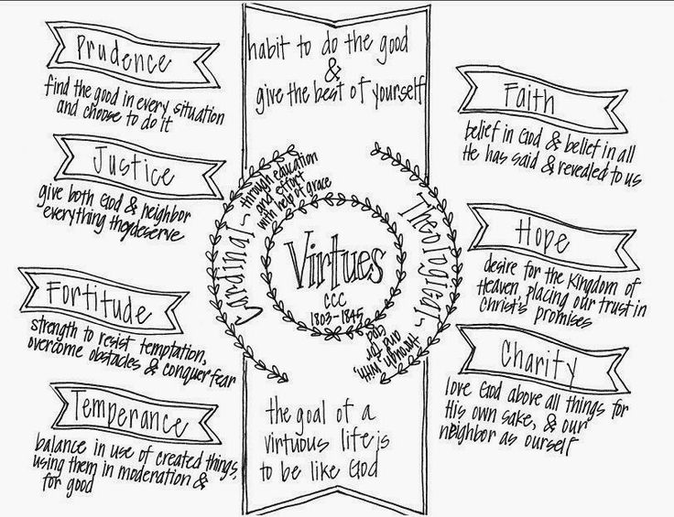
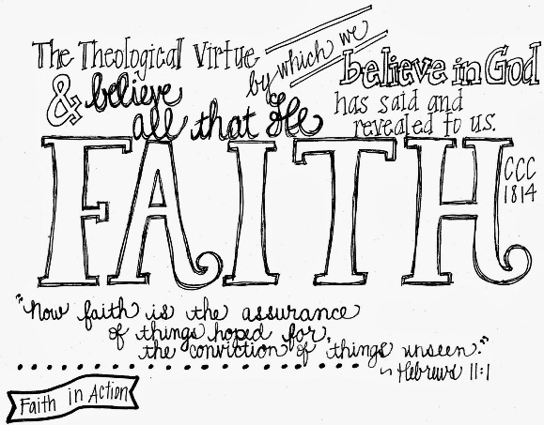
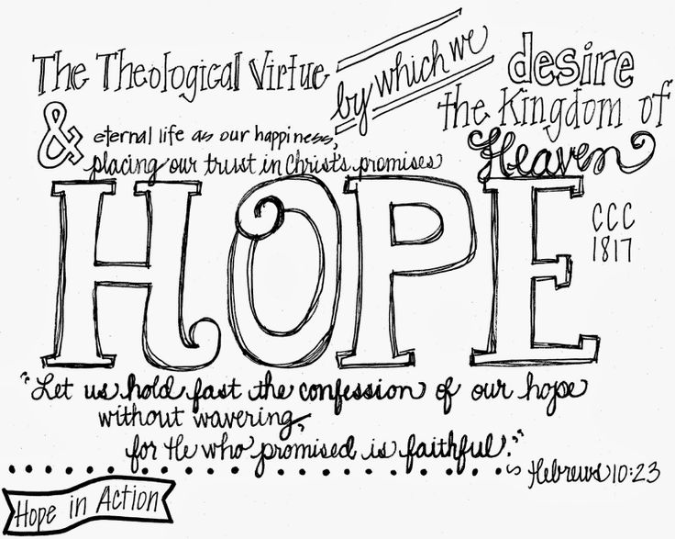
3 Theological virtues (biblical)
1. Faith: belief in God (and Others)
2. Hope: perseverance and striving
3. Love: a charitable compassion toward others

Slide 14
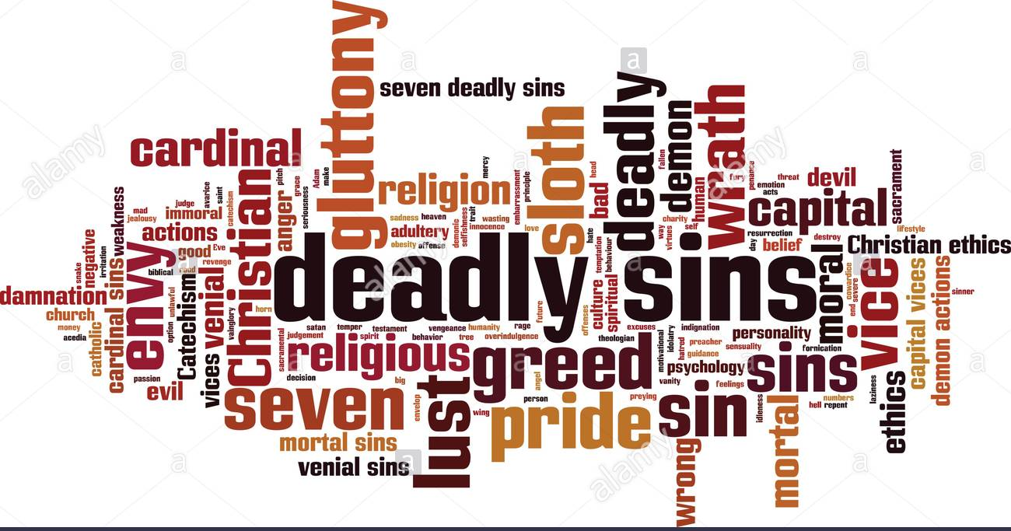
7 vices

Slide 15
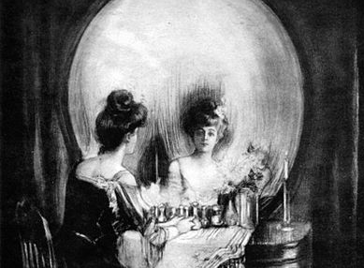
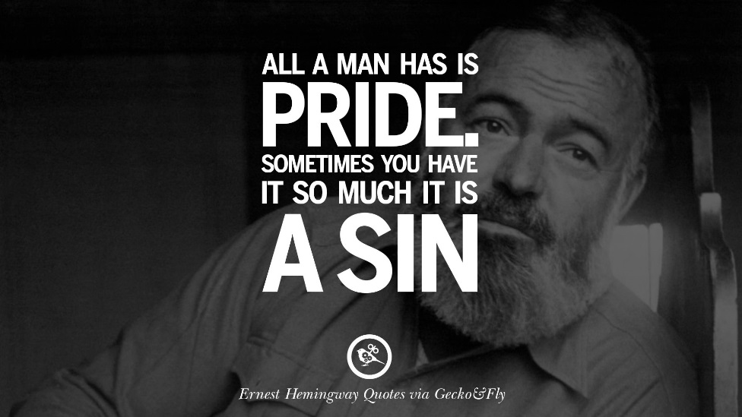
1. pride
most serious of the vices
identified as a desire to be more important or attractive than others, failing to acknowledge the good work of others, and excessive love of self (especially holding self out of proper position toward God).

Slide 16
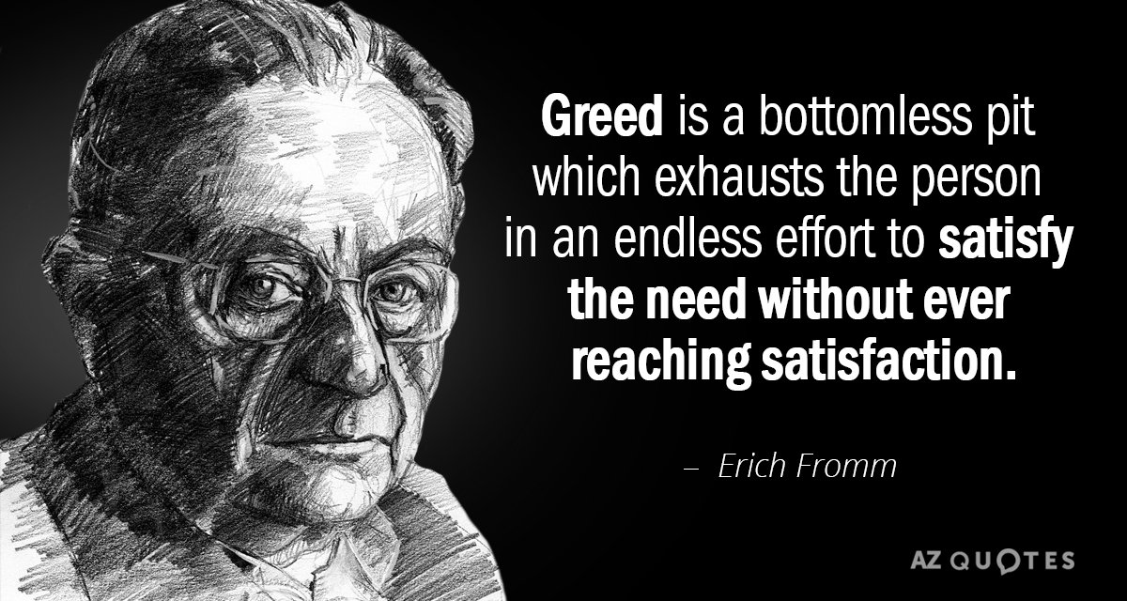
2. Greed
a vice of excess.
the excessive desire and pursuit of wealth, power, and status.

Slide 17
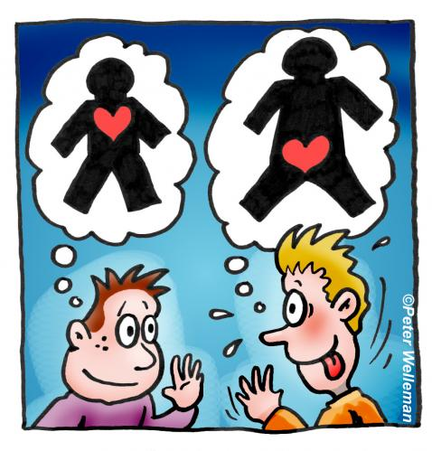
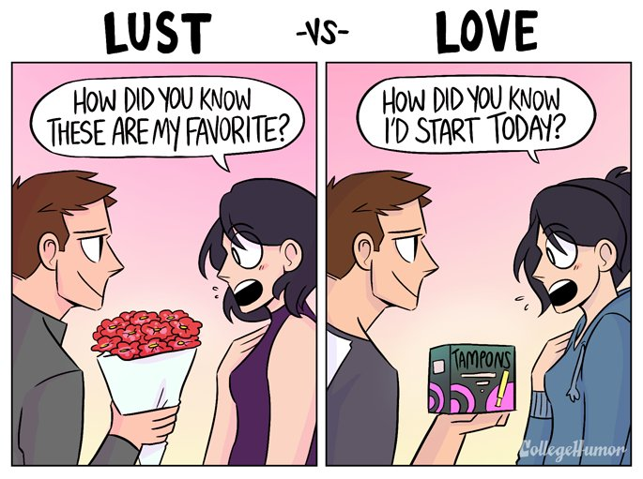
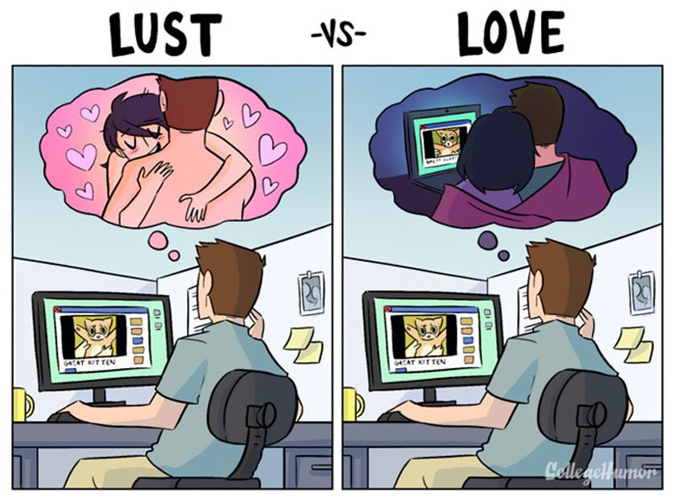
3. lust
having excessive thoughts or desires of a sexual nature.
Aristotle’s criterion was excessive love of others, which therefore rendered love and devotion to God secondary.

Slide 18
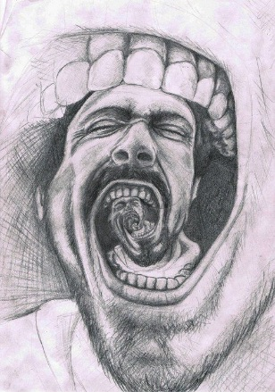
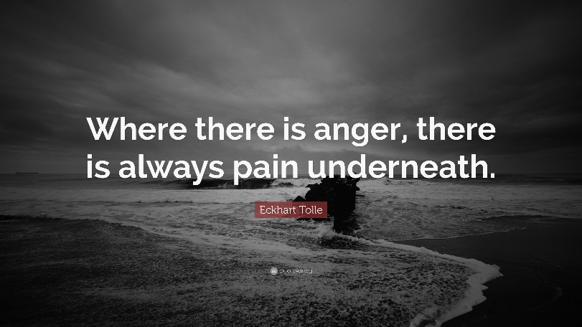
4. anger
uncontrolled feelings of hatred and anger
generally wishing to do evil or harm to others

Slide 19
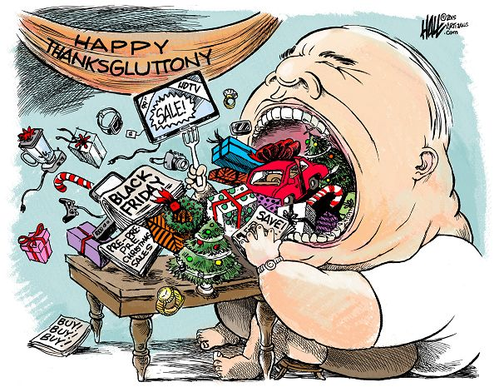
5. gluttony
over-indulgence and over-consumption of anything to the point of waste
in the Christian religions, it is considered a sin because of the excessive desire for food, or its withholding from the needy

Slide 20
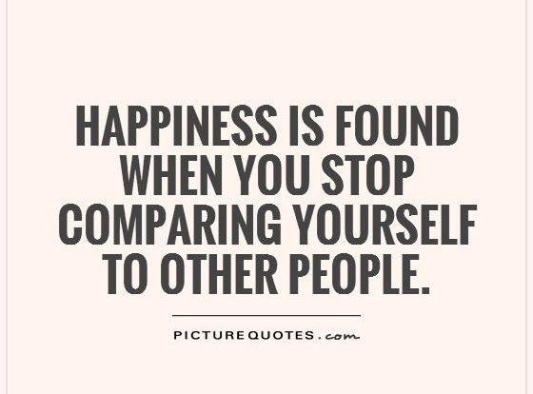
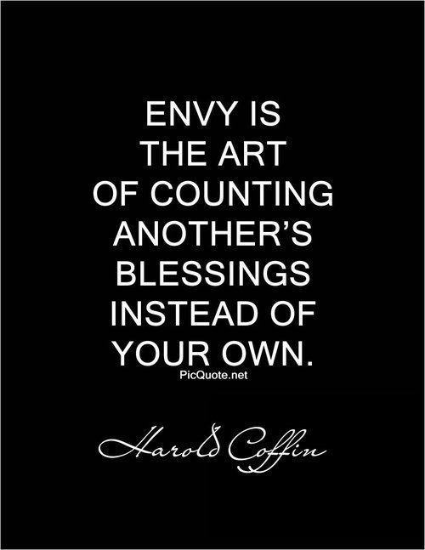
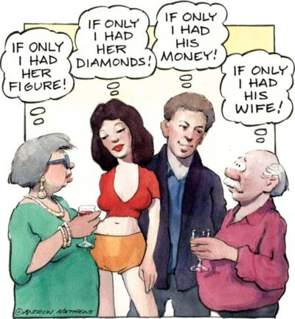
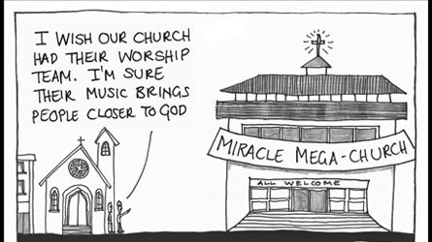
6. envy
someone desiring something that they do not possess
many times the person resents someone for having something that they do not have

Slide 21
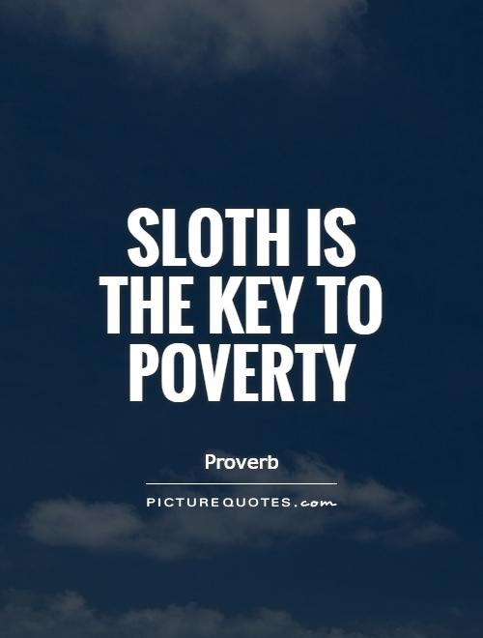
7. sloth
this is laziness and indifference

