Slide 1
Types of Truth

Slide 2
Kinds of Truth
1) Religious
2) Moral
3) Symbolic
4) Proverbial
5) Historical
6) Scientific

Slide 3
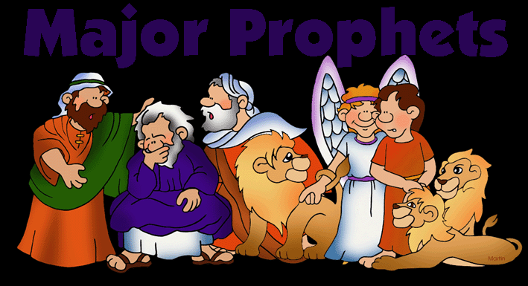
Religious Truth
Truth based on faith
Example: God tries to communicate with people through their lives

Slide 4
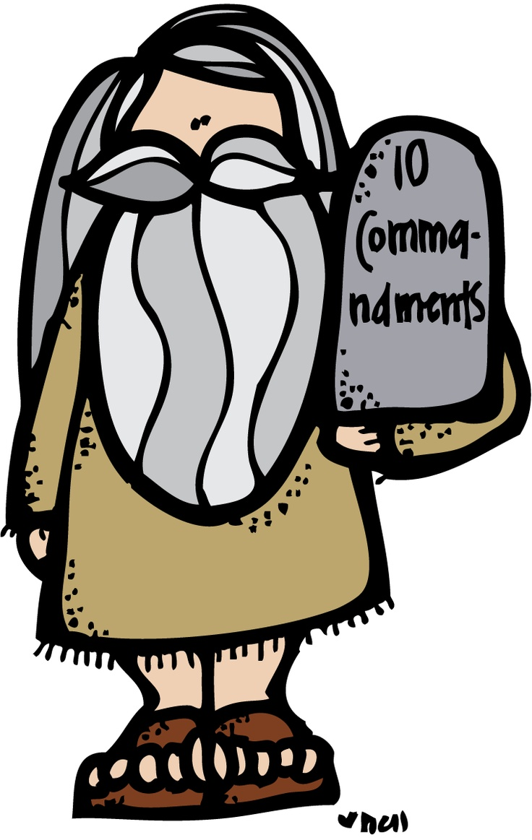
Moral Truth
The distinction between wrong and right
Helps us to know how to act toward one another
Beatitudes and 10 Commandments
Example: “Thou shall not kill”

Slide 5
Symbolic Truth
Something used for or regarded as representing something else
Much of the truth in scripture is told by symbols – we must read between the lines to discover the truth being presented
Example: “If your eyes cause you to sin, pluck them out”
Example: Tree of knowledge

Slide 6
Proverbial Truth
A short popular saying, usually of unknown and ancient origin that expresses effectively some commonplace truth or useful thought
Wise saying
Example: “The early bird catches the worm”

Slide 7
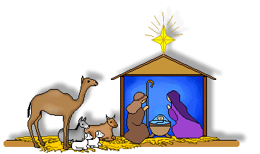
Historical Truth
Knowledge that deals with past events
Much of what is written is accurate, but there are some historical errors in the Bible
Example: Jesus was born in Bethlehem and lived in Nazareth

Slide 8
Scientific Truth
A branch of knowledge or study dealing with a body of facts or truths
Example: 2 + 2 = 4

