Slide 1
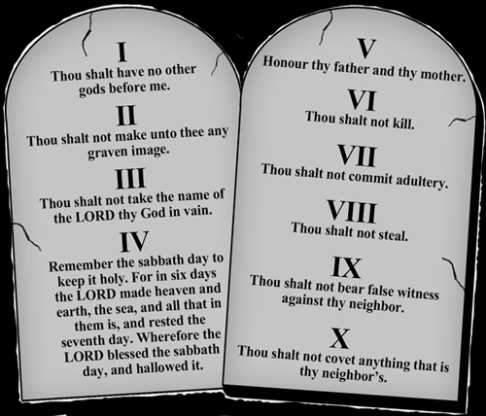
The Ten Commandments

Slide 2
Brief History
Moses received them from God.
Story of Moses
Isrealite in Egypt
Isrealites slaves in Egypt
Pharoah orders all firstborn Isrealite boys to be killed
Set adrift on river in basket, found by Pharoah’s daughter
Raised by mother as an Egyptian
Witnessed Egyptian beating Isrealite slave, kills him
Flees Egypt, becomes shepherd
God speaks to Moses through burning bush
Moses returns to Egypt and pleads Pharoah to free the Isrealites, no luck
10 plagues (water to blood, frogs, locusts, boils, hail, darkness, flies, plagues, death of firstborn sons of Egyptians)
Isrealites flee, Egyptian army chases
Moses parts Red Sea
Isrealites travel through desert, God gives them food and water
God gives Moses 10 Commandments on Mount Sinai
= Moses led his people to their homeland with God’s help

Slide 3
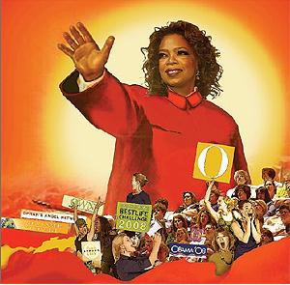
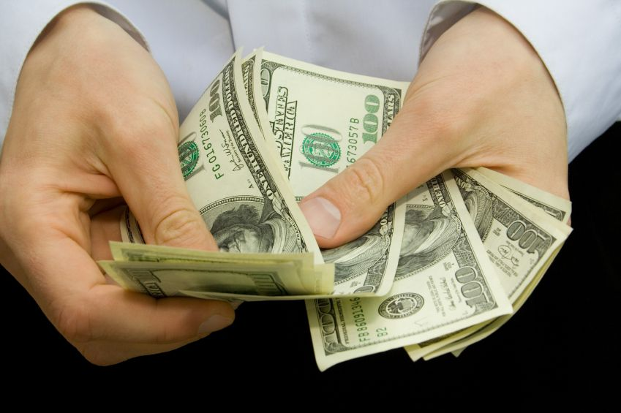
1. I am the Lord your God, do not have false Gods
God made our world and created each one of us
He wants us to know that He loves us and that He will always be with us
There are times when we forget and we make other people and things more important – this is wrong
Have faith in God – he is the ultimate source of our existence
Don’t put material things or other idols before God
Don’t be overly superstitious (horoscopes, fortune-telling, ouiji boards, etc)

Slide 4
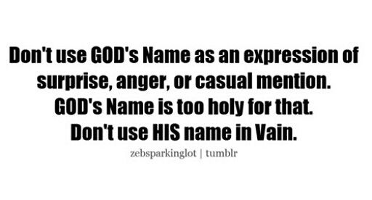
2. Do not take God’s name in vain
Do not dishonour your own name or anyone else’s, especially God’s
Cursing, speaking disrespectfully
Misusing God’s name

Slide 5
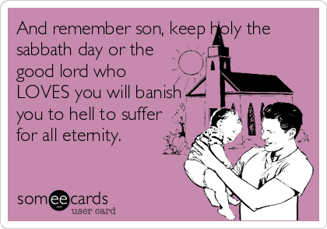
3. Keep Holy the Lord’s day
God wants us to have a day of rest, when we can put aside our work and just think of how much we are loved by God – Sunday
Holy day of obligation
Going to church on Sunday to spend time with God, listen to His word and pray for ourselves and others

Slide 6
4. Honour your mother and father
Parents are your best teachers
Respect your family and care for their well-being

Slide 7
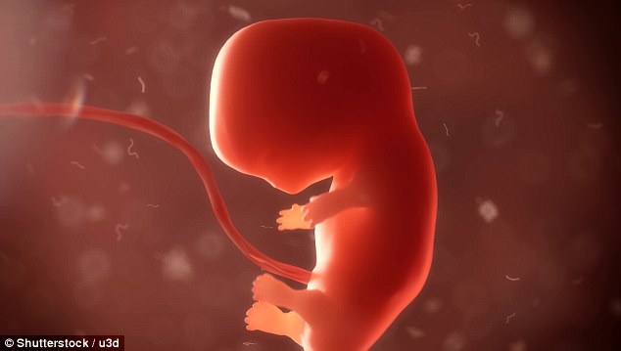
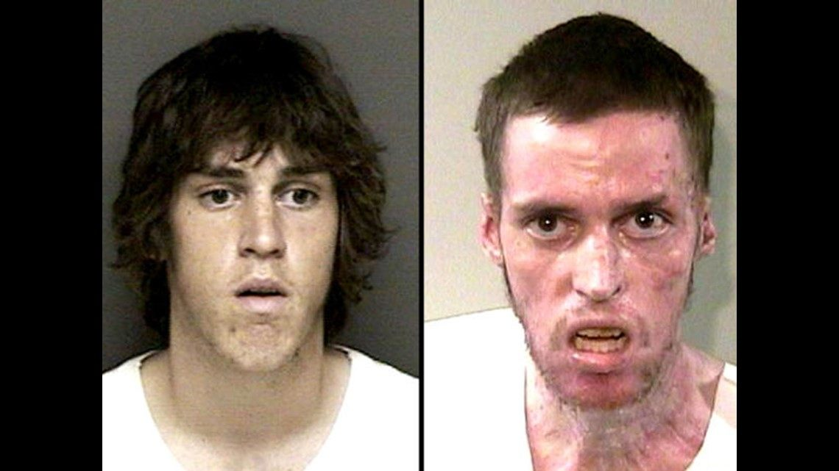
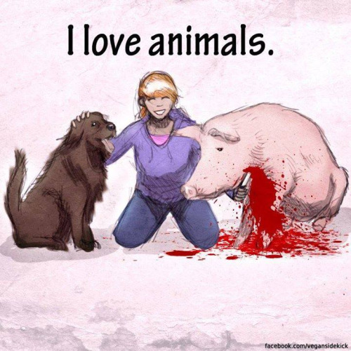
5. Do not kill
God gave us life, we should treat it with respect
When we fight, or do disrespectful things, we are killing the special joy and peace that is given to us by God
Live in peace with others
Respect your body
Abortion, suicide, fighting, endangering your life or life of others

Slide 8
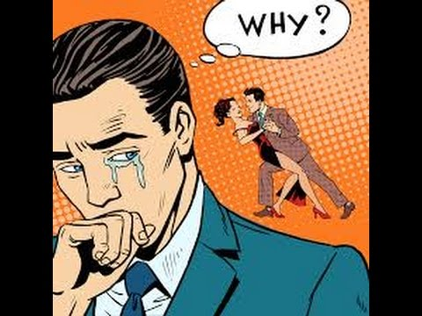
6. Do not commit adultery
Mostly for married people
When 2 people get married, they promise to share their love only with each other

Slide 9
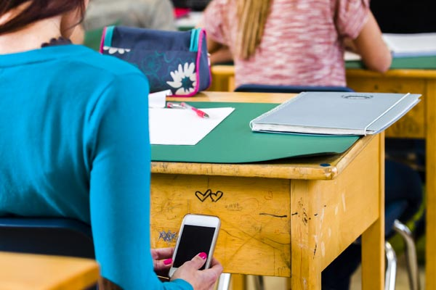
7. Do not steal
Selfish and harmful
Everyone has a right to what belongs to them
Cheating, not returning what is found/borrowed, not paying just wages, bribery, fraud

Slide 10
8. Do not lie
Lies hurt the respect we have of ourselves and it usually hurts another person
Do not backstab, talk poorly about others, gossip, spread rumours, tell secrets

Slide 11
9. Honour your neighbour’s wife
Be pure in thoughts and desires

Slide 12
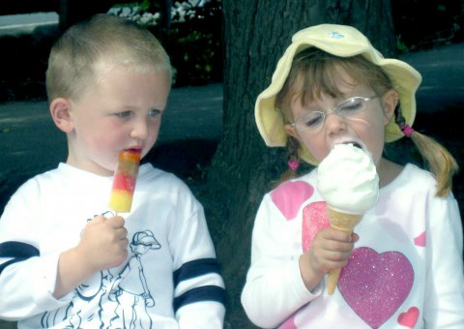
Honour your neighbour’s goods
Be happy with what you have
Respect others’ property
Don’t be jealous

