Slide 1
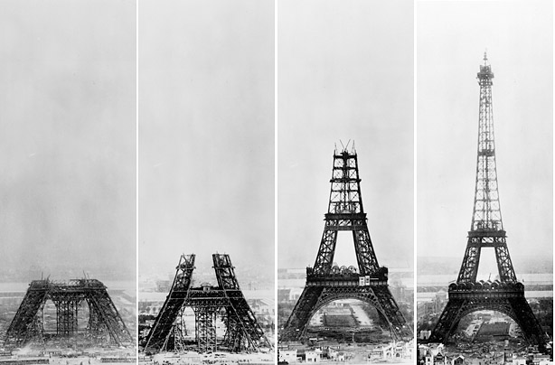
Stages of Faith

Slide 2
Stages of Faith
There are 3 main stages through which our faith passes:
The Childhood Stage
The Adolescent Stage
The Adult Stage

Slide 3
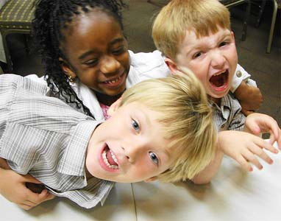
The Childhood Stage
We are born into a particular religion and our faith comes from what our parents teach us.

Slide 4
The Adolescent Stage
It is the most important stage because we begin to question what we have been told so far.
We begin to ask questions and find out answers for ourselves.

Slide 5
The Adult Stage
We make our decisions by ourselves and we have faith in the choices that we have made.
This stage is never complete because we always have questions about matters of faith.

