Slide 1
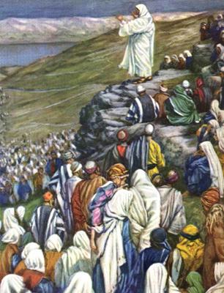
THE EIGHT BEATITUDES OF JESUS

Slide 2
What are the Beatitudes?
The word beatitude means “blessing” or “promise of true happiness”
In biblical times, beatitudes were often given as directions for life
Statements of popular wisdom or common sense
The Beatitudes that Jesus gives us are different
They direct us along paths where we would not expect to find happiness.
Jesus’ Beatitudes will lead us to the happiness of true and lasting friendship with others and with God.
The 10 Commandments & the Beatitudes are stepping stones to the Kingdom of Heaven.

Slide 3
How it all started…
One day when many people had gathered around Jesus, he went up onto a hill and began to teach.
Jesus told his listeners ways to live in order to be truly happy.
This is called the Sermon on the Mount.

Slide 4
First Beatitude
"Blessed are the poor in spirit, for theirs is the kingdom of heaven”
It’s about being humble or modest
Be happy even if we feel poor or at the end of our rope
Don’t brag, don’t be a show off, help others as Christ showed us.

Slide 5
Second Beatitude
“Blessed are they who mourn, for they shall be comforted”
It’s about not being detached from a person’s pain or suffering
Christianity is about caring for all humanity
Caring, thinking for others, sympathy, empathy, mourning for/with the innocent people affected by war

Slide 6
Third Beatitude
“Blessed are the meek, for they shall inherit the earth”
It’s about being gentle, kind in actions and words
Kind, soothing, easy going, get along with others.

Slide 7
Fourth Beatitude
“Blessed are they who hunger and thirst for righteousness, for they shall be satisfied”
It’s about being fair, longing for complete goodness and doing what is right both morally and consciously
Righteousness – fairness and justice
Sharing, being equal, not greedy, standing up for what is right

Slide 8
Fifth Beatitude
“Blessed are the merciful, for they shall obtain mercy”
It’s about being forgiving to those who hurt us
Golden rule: treat others as you would like to be treated
Not to hold grudges, be more accepting, choosing not to punish or react but learn the other person’s viewpoint

Slide 9
Sixth Beatitude
“Blessed are the pure of heart, for they shall see God”
It’s about having integrity, honesty, and sincerity and to be free of selfishness
Have pure motives, no hidden plans
Do good things for others without expecting a reward, recognition or a favour in return

Slide 10
Seventh Beatitude
“Blessed are the peacemakers, for they shall be called children of God”
Its about being peaceful and choosing to resolve problems without violence
Not bullying, not harassing others, talking through disagreements

Slide 11
Eighth Beatitude
“Blessed are they who are persecuted for the sake of righteousness, for theirs is the kingdom of heaven"
It’s about having courage to do what is right even though it may upset others
Stand up for your morals or beliefs

