Slide 1
Body Image & Self Esteem
Physical Dimension

Slide 2
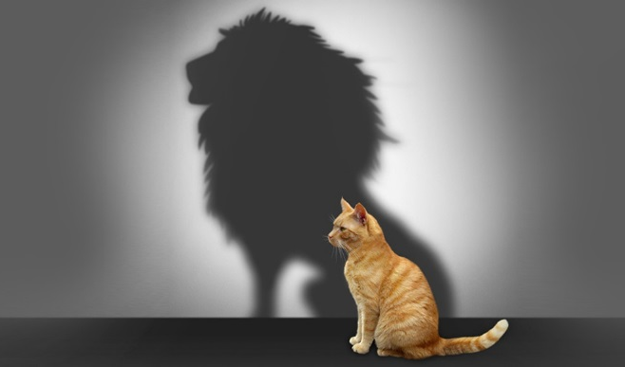
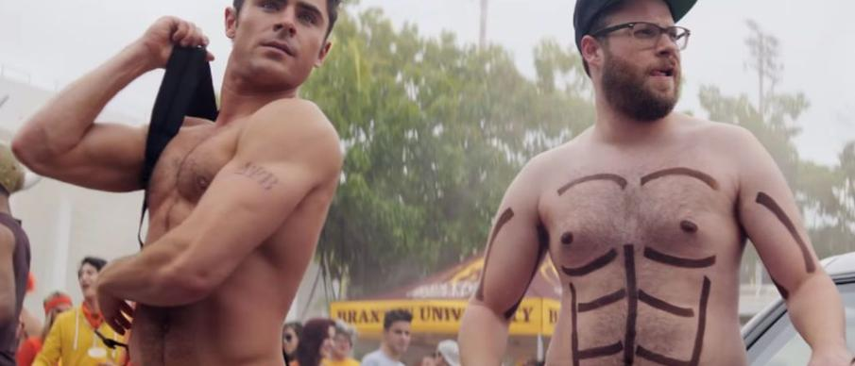
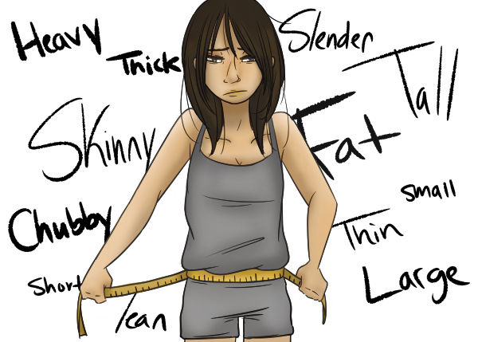
Body Image
How you feel about your body
Having a positive body image reflects self acceptance, high self esteem and a caring about your body and your health
Body image vs media (4 min) - https://www.youtube.com/watch?v=24Xa1Nw8eJY

Slide 3
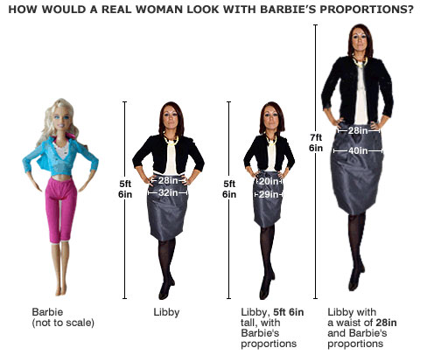
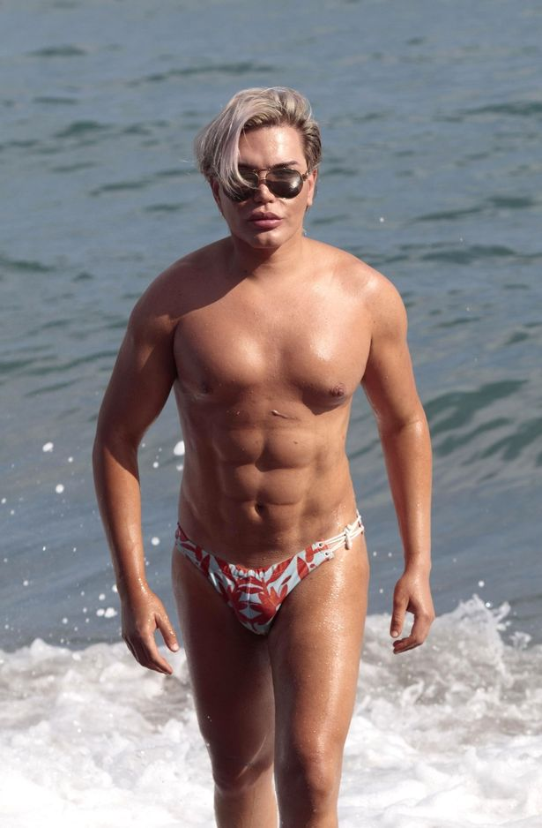
Body Image

Slide 4
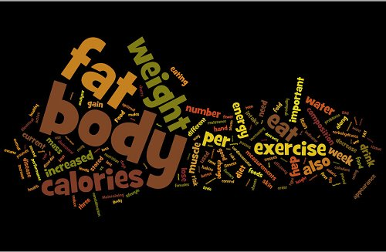
Body Image: Influences
Rate of growth
Friends
Magazines
Social Media
Parents
Teachers
TV
Advertising
Fashion trends
Media and body image (10 min)- https://www.youtube.com/watch?v=Jgz4_G8p7TM

Slide 5
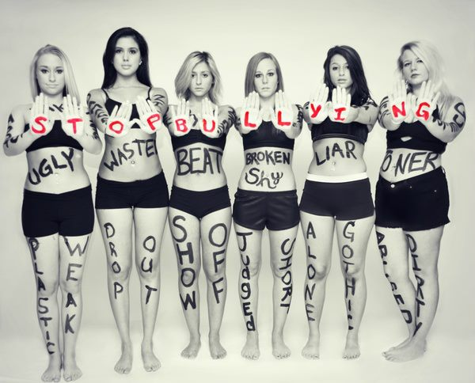
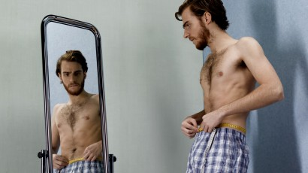
Body Image
Negative Body Image
A distorted perception of your shape, or feelings of discomfort, shame, or anxiety about your body
Positive Body Image
A true perception of your appearance: You see yourself as you really are and you like yourself

Slide 6
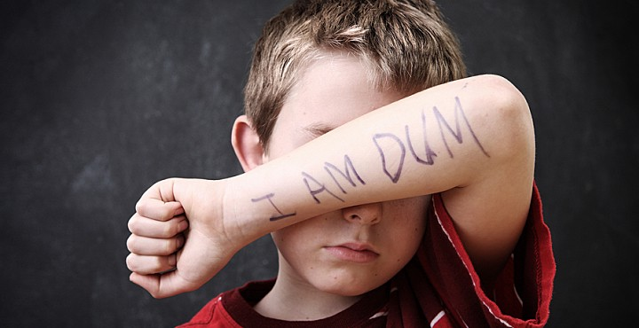
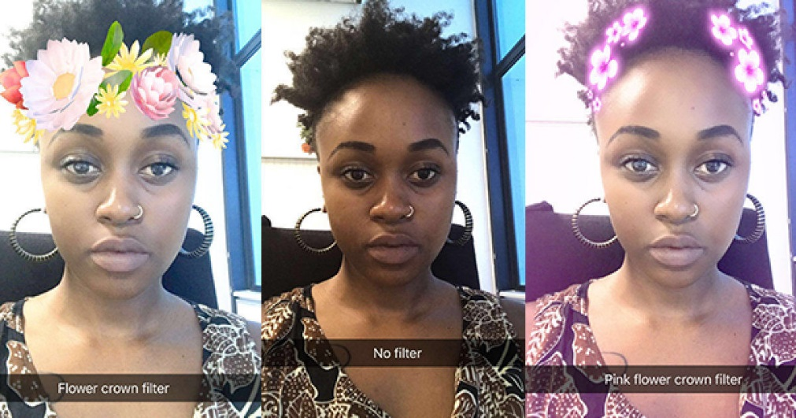
Self Esteem
A person’s feelings
about his/her
own worth
The opinion you have of yourself and how you value yourself as a person

Slide 7
Self Esteem
When did you stop thinking you were beautiful? (1 min) - https://www.youtube.com/watch?v=4HiRSJ3Hrmg
Dove sketches (3 min) - https://www.youtube.com/watch?v=XpaOjMXyJGk

Slide 8
Signs of low self esteem
avoiding new things and not taking up opportunities
feeling unloved and unwanted
blaming others for their own mistakes
not being able to deal with normal levels of frustration
negative self-talk and comparisons to others
fear of failure or embarrassment
difficulty making friends
low levels of motivation and interest
can’t take compliments and shows mixed feelings of anxiety or stress

Slide 9
Causes of low self-esteem
unsupportive parents, caregivers or others that play an influential role in their life
friends who are bad influences
stressful life events such as divorce or moving houses
trauma or abuse
poor performance at school or unrealistic goals
mood disorders such as depression
anxiety
bullying or loneliness
ongoing medical issues

Slide 10
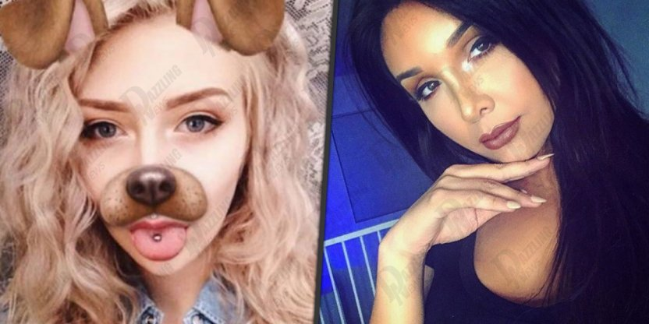
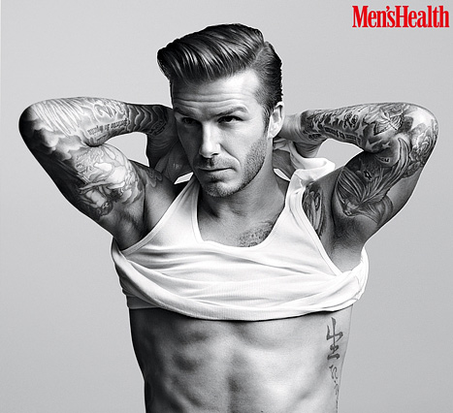
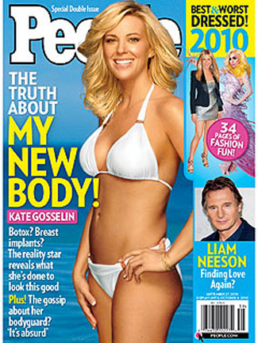
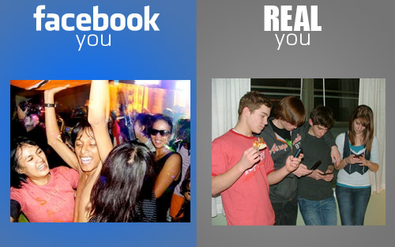
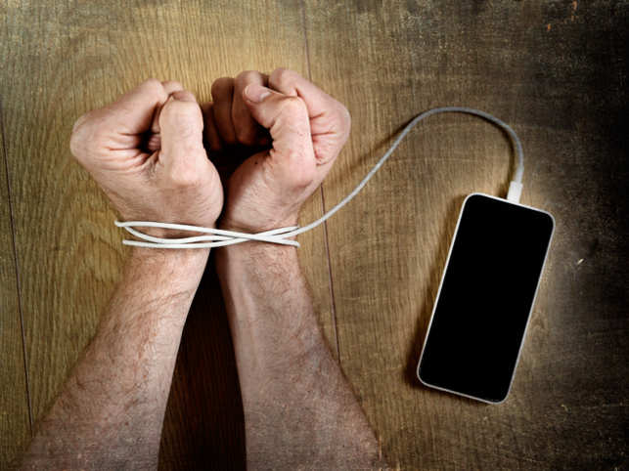
Media – Huge impact

Slide 11
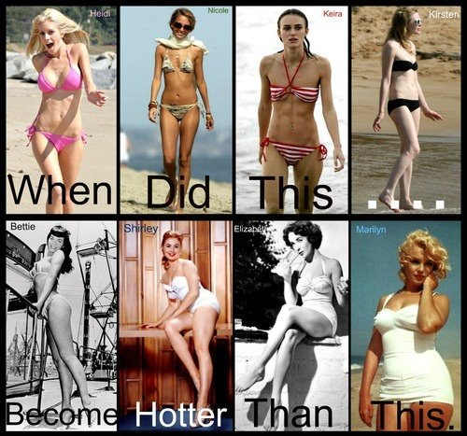
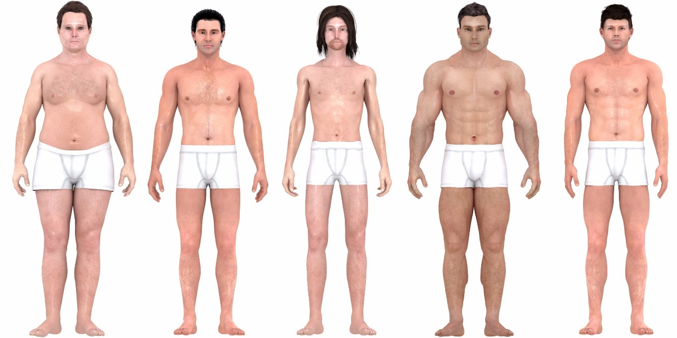
Today vs Old School

Slide 12
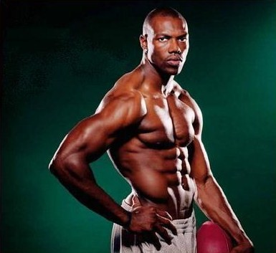
Today’s world
Competition
Control
Perfection
I want it all
Nike commercial my better is better. http://www.youtube.com/watch?v=rHHMaiNyztk
Botox case… mom inject 8 year old daughter with botox (5 min)
http://www.youtube.com/watch?v=1EOgkA3p9zI
What is this world coming to?
Priorities??

Slide 13
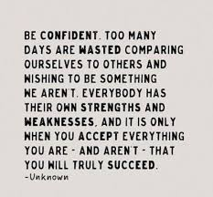
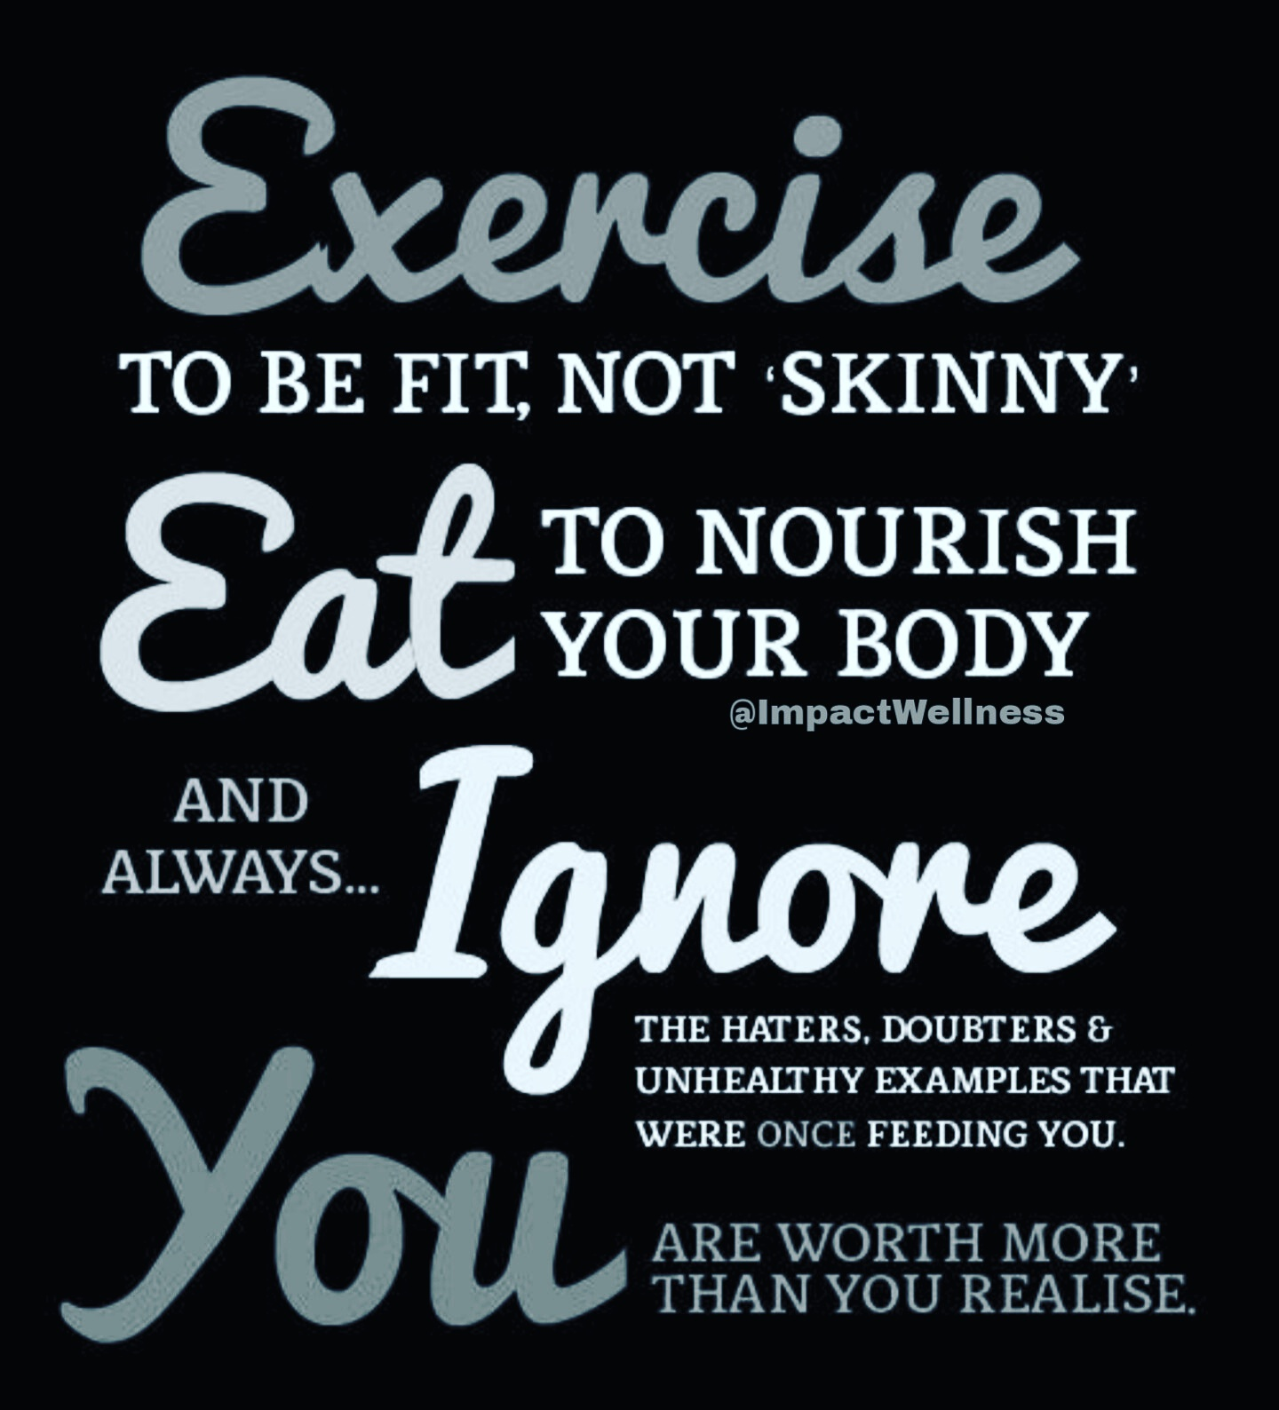
God Created all of us in his image
Every person is unique
Every person has special talents
Be yourself
Daily affirmations (cute) - https://www.youtube.com/watch?v=qR3rK0kZFkg

