Slide 1
SPIES
The 5 dimensions of personality

Slide 2
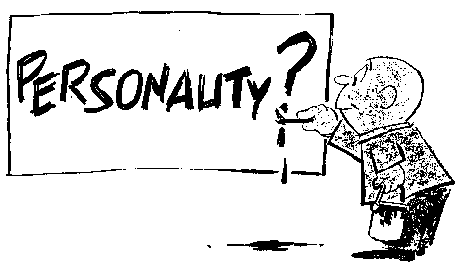
Every Person has 5 dimensions
The five dimensions of a personality are the following
SOCIAL
PHYSICAL
INTELLECTUAL
EMOTIONAL
SPIRITUAL
S.P.I.E.S.

Slide 3
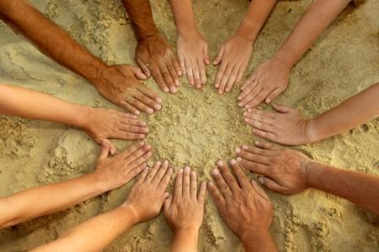
Social
How you interact with people around you
Your relationships with family and friends

Slide 4
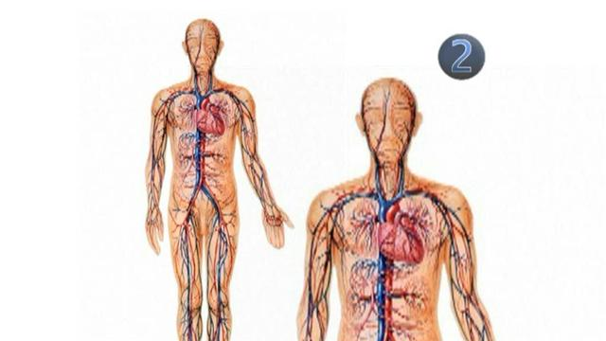
Physical
How you treat your body
How you use your body
The physical activities you enjoy
Your physical strengths and weaknesses

Slide 5
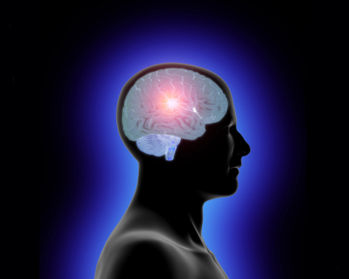
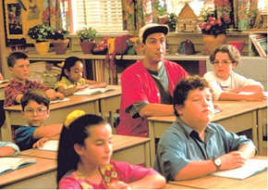
Intellectual
What kind of student at school and in life are you?
What kind of learner are you?
What are your “smart gifts”?

Slide 6
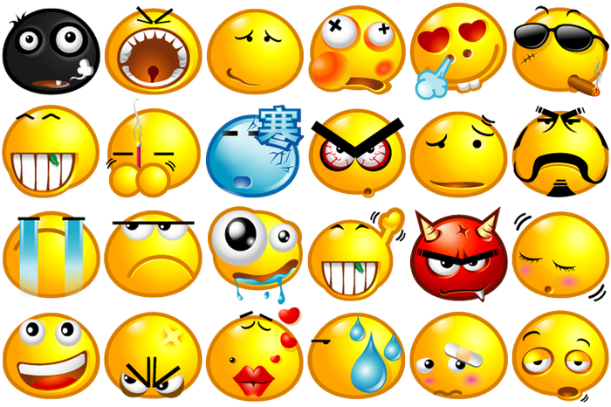
Emotional
Who are you emotionally inside and out?
What your passions are
How you emotionally connect with others

Slide 7
Spiritual
What is your relationship with God?
Where are you in your Faith Journey?

Slide 8
Reflection
Examine the list of traits/qualities of friendships
Select the 5 most important traits or qualities you look for in a friendship/relationship
Write journal reflection:
What qualities do you possess that embody what a friend should be? Explain
Which quality/qualities do you need to work on a friendship/relationship? Explain

Slide 9
Qualities of Friendship
Joyful
Humble
Good listener
Sensitive
Non-judgmental
In control
Patient
Creative
Brace
Fair
Responsible
Loving
Polite
Supportive
Helpful
Gentle
Sympathetic
Accepting
Good-looking
Funny
Energetic
Honest
Smart
Wise
Fun
Athletic
Talkative …

